Slide 1
Deadlock detection in FPGA design: A practical approach
https://ieeexplore.ieee.org/document/7085635

Slide 2
Why? What problem are the author(s) trying to solve?
Deadlock Detection in FPGA Design
*FPGA - Field Programmable Gate Array

Slide 3
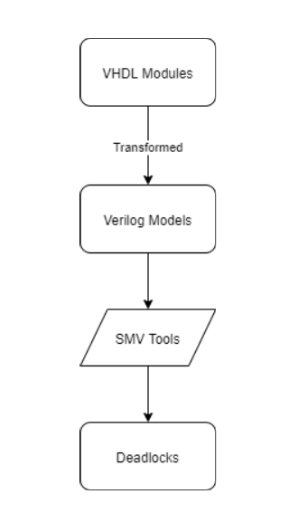
How? What method has been used to answer the question?
Semi-automatic way to verify FPGA VHDL software deadlocks
*FPGA - Field Programmable Gate Array
*VHDL - VHSIC Hardware Description Language

Slide 4
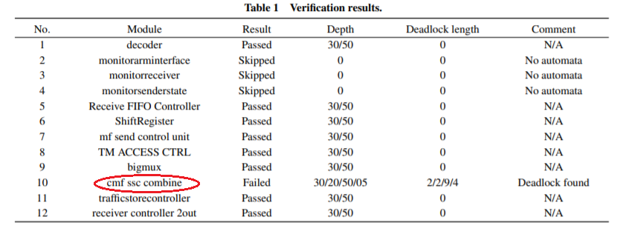
What is the result from the method?

Slide 5
Does the research solve the problem/answer the question?
YES

Slide 6
What are to be done next? future work? and why?
Extend verification range
Specify the depth of the SAT solver manually
Use Binary Decision Diagram

Slide 7
Deadlock detection in FPGA design: A practical approach
https://ieeexplore.ieee.org/document/7085635

